Slide 1
Software Project Management

Slide 2
Introduction
Many software projects fail:
  due to faulty project management practices:
    It is important to learn different aspects of software project management.

Slide 3
Introduction
Goal of software project management:
  enable a group of engineers to work efficiently towards successful completion of a software project.

Slide 4
Project Manager
A project manager is usually a experienced member of the team who especially works as the administrative leader of the team.

Slide 5
Software Project Management Complexities
Invisibility :- Software remains invisible, until its development is complete and its operational.
Changeability:- Frequent changes to the requirements and invisibility of software are two major factors.

Slide 6
Complexity :- Number of functions, data coupling.
Uniqueness:- Every project is unique and associated with new features.
Team oriented and Intellect-intensive work-

Slide 7
Responsibility of project managers
Project proposal writing,
Project cost estimation,
Scheduling,
Project staffing,
Project monitoring and control,
Software configuration management,
Risk management,
Managerial report writing and presentations, etc.

Slide 8
Introduction
A project manager’s activities are varied.
  can be broadly classified into:
    project planning,
    project monitoring and control activities.

Slide 9
Project Planning
Once a project is found to be feasible,
  project managers undertake project planning.

Slide 10
Project Planning Activities
Estimation:
  Effort, cost, resource, and project duration
Project scheduling:
Staff organization:
  staffing plans
Risk handling:
  identification, analysis, and abatement procedures
Miscellaneous plans:
  quality assurance plan, configuration management plan, etc.

Slide 11
Project planning
Requires utmost care and attention --- commitments to unrealistic time and resource estimates result in:
  irritating delays.
  customer dissatisfaction
  adverse affect on team morale
    poor quality work
  project failure.

Slide 12
Project Monitoring
The focus of project monitoring and control activities is to ensure that the software development proceeds as per plan.

Slide 13
Which of the following activity is undertaken immediately after feasibility study and before the requirement analysis and specification phase?
A. Project Planning
B. Project Monitoring
C. Project Control
D. Project Scheduling

Slide 14
Sliding Window Planning
Involves project planning over several stages:
  protects managers from making big commitments too early.
  More information becomes available as project progresses.
    Facilitates accurate planning

Slide 15
SPMP Document
After planning is complete:
  Document the plans:
  in a Software Project Management Plan(SPMP) document.

Slide 16
Organization of SPMP Document
  Introduction (Objectives,Major Functions,Performance Issues,Management and Technical Constraints)
  Project Estimates (Historical Data,Estimation Techniques,Effort, Cost, and Project Duration Estimates)
  Project Resources Plan (People,Hardware and Software,Special Resources)
  Schedules (Work Breakdown Structure,Task Network, Gantt Chart Representation,PERT Chart Representation)
  Risk Management Plan (Risk Analysis,Risk Identification,Risk Estimation, Abatement Procedures)
  Project Tracking and Control Plan
  Miscellaneous Plans(Process Tailoring,Quality Assurance)

Slide 17
Software Cost Estimation
Determine size of the product.
From the size estimate,
  determine the effort needed.
From the effort estimate,
  determine project duration, and cost.

Slide 18
Software Cost Estimation
Effort Estimation
Cost Estimation
Size Estimation
Staffing Estimation
Duration Estimation
Scheduling

Slide 19
This activity is undertaken once the development activities start?
A. Project Planning
B. Project Monitoring and Control
C. Project size estimation
D. Project cost estimation

Slide 20
Software Size Metrics
LOC (Lines of Code):
  Simplest and most widely used metric.
  Comments and blank lines should not be counted.

Slide 21
Disadvantages of Using LOC
Size can vary with coding style.
Focuses on coding activity alone.
Correlates poorly with quality and efficiency of code.
Penalizes higher level programming languages, code reuse, etc.

Slide 22
Disadvantages of Using LOC (cont...)
Measures lexical/textual complexity only.
  does not address the issues of structural or logical complexity.
Difficult to estimate LOC from problem description.
  So not useful for project planning

Slide 23
During project estimation, project manager estimates following
A. project cost
B. project duration
C. project effort
D. all of the above

Slide 24
Function Point Metric
Overcomes some of the shortcomings of the LOC metric
Proposed by Albrecht in early 80's:
Input:
  A set of related inputs is counted as one input.

Slide 25
Function Point Metric
Output:
  A set of related outputs is counted as one output.
Inquiries:
  Each user query type is counted.
Files:
  Files are logically related data and thus can be data structures or physical files.
Interface:
  Data transfer to other systems.

Slide 26
Function Point Metric (CONT.)
Suffers from a major drawback:
  the size of a function is considered to be independent of its complexity.
Extend function point metric:
  Feature Point metric:
  considers an extra parameter:
    Algorithm Complexity.

Slide 27
Function Point Metric (CONT.)
Proponents claim:
  FP is language independent.
  Size can be easily derived from problem description
Opponents claim:
  it is subjective --- Different people can come up with different estimates for the same problem.

Slide 28
Function point (FP) metric computation
Step 1: Compute the unadjusted function point (UFP) using a heuristic expression.
Step 2: Refine UFP to reflect the actual complexities of the different parameters used in UFP computation.
Step 3: Compute FP by further refining UFP to account for the specific characteristics of the project that can influence the entire development effort.

Slide 29
Step 1: UFP computation
The unadjusted function points (UFP) is computed as the weighted sum of five characteristics of a product as shown in the following expression.
UFP = (Number of inputs)*4 + (Number of outputs)*5 + (Number of inquiries)*4 + (Number of files)*10 + (Number of interfaces)*10

Slide 30
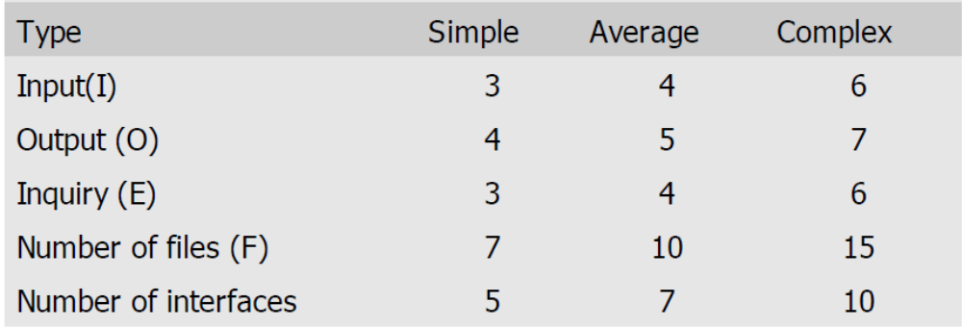
Step 2: Refine parameters
The complexity of each parameter is graded into three broad categories—simple, average, or complex.

Slide 31
Step 3: Refine UFP based on complexity of the overall project
Albrecht identified 14 parameters that can influence the development effort.
Each of these 14 parameters is assigned a value from 0 (not present or no influence) to 5 (strong influence).
The resulting numbers are summed, yielding the total degree of influence (DI).
DI = 14 * No. of influence
TCF (technical complexity factor) = (0.65+0.01*DI)
FP = UFP*TCF

Slide 32
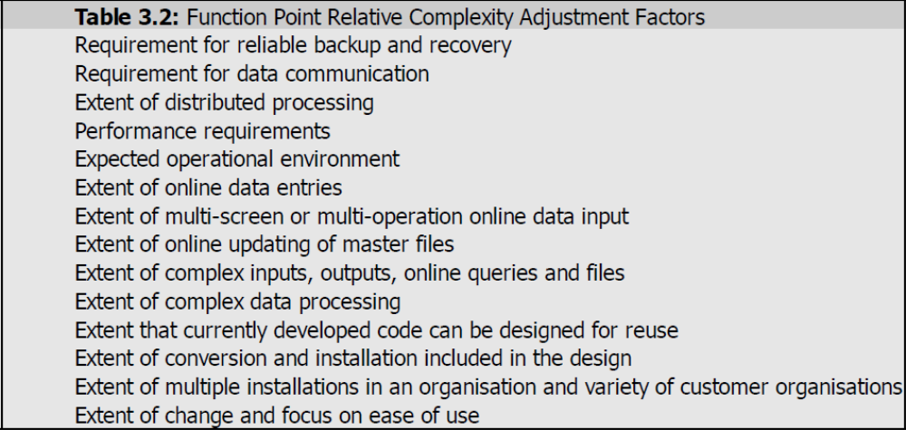

list of these Parameters

Slide 33
Software Project Planning
Table 3 : Computing function points.
Rate each factor on a scale of 0 to 5.
0
1
2
3
4
5
No
Influence
Incidental
Moderate
Average
Significant
Essential
Number of factors considered ( F_{i} )
1. Does the system require reliable backup and recovery ?
2. Is data communication required ?
3. Are there distributed processing functions ?
4. Is performance critical ?
5. Will the system run in an existing heavily utilized operational environment ?
6. Does the system require on line data entry ?
7. Does the on line data entry require the input transaction to be built over multiple screens or operations ?
8. Are the master files updated on line ?
9. Is the inputs, outputs, files, or inquiries complex ?
10. Is the internal processing complex ?
11. Is the code designed to be reusable ?
12. Are conversion and installation included in the design ?
13. Is the system designed for multiple installations in different organizations ?
14. Is the application designed to facilitate change and ease of use by the user ?

Slide 34
Software Project Planning
Example: 4.1
Consider a project with the following functional units:
Number of user inputs = 50
Number of user outputs = 40
Number of user enquiries = 35
Number of user files = 06
Number of external interfaces = 04
Assume all complexity adjustment factors and weighting factors are average. Compute the function points for the project.

Slide 35
Software Project Planning
Solution
We know
UFP = 50 x 4 + 40 x 5 + 35 x 4 + 6 x 10 + 4 x 7
= 200 + 200 + 140 + 60 + 28 = 628
TCF = (0.65 + 0.01 ΣF_{i})
= (0.65 + 0.01 (14 x 3)) = 0.65 + 0.42 = 1.07
FP = UFP x TCF
= 628 x 1.07 = 672

Slide 36
Software Project Planning
Example:4.2
An application has the following:
10 low external inputs, 12 high external outputs, 20 low internal logical files, 15 high external interface files, 12 average external inquiries, and a value of Technical complexity factor of 1.10.
What are the unadjusted and adjusted function point counts ?

Slide 37
Software Project Planning
Solution
Unadjusted function point counts may be calculated using as:
= 10 x 3 + 12 x 7 + 20 x 7 + 15 x 10 + 12 x 4
= 30 + 84 +140 + 150 + 48
= 452
FP = UFP x TCF
= 452 x 1.10 = 497.2.

Slide 38
Which of the following is not project management goal?
a) Keeping overall costs within budget
b) Delivering the software to the customer at the agreed time
c) Maintaining a happy and well-functioning development team
d) Avoiding customer complaints

Slide 39
Project Estimation Technique
Three main approaches to estimation:
  Empirical
  Heuristic
  Analytical

Slide 40
Project Estimation Technique
Empirical techniques:
  an educated guess based on past experience.
Heuristic techniques:
  assume that the characteristics to be estimated can be expressed in terms of
  some mathematical expression.
Analytical techniques:
  derive the required results starting from certain simple assumptions.

Slide 41
Empirical Size Estimation Techniques
Expert Judgement:
  An euphemism for guess made by an expert.
  Suffers from individual bias.
Delphi Estimation:
  overcomes some of the problems of expert judgement.

Slide 42
Expert judgement
Experts divide a software product into component units:
  e.g. GUI, database module, data communication module, billing module, etc.
Add up the guesses for each of the components.

Slide 43
Delphi Estimation:
Team of Experts and a coordinator.
Experts carry out estimation independently:
  mention the rationale behind their estimation.
  coordinator notes down any extraordinary rationale:
    circulates among experts.

Slide 44
Delphi Estimation:
Experts re-estimate.
Experts never meet each other
  to discuss their viewpoints.

Slide 45
Heuristic Estimation Techniques
Single Variable Model:
  Parameter to be Estimated=C1(Estimated Characteristic)d1
Multivariable Model:
  Assumes that the parameter to be estimated depends on more than one characteristic.
  Parameter to be Estimated=C1(Estimated Characteristic)d1+ C2(Estimated Characteristic)d2+…
  Usually more accurate than single variable models.

Slide 46
Single Variable Estimation Models:
It provides a means to estimate the desired characteristics Of a problem, using some previously estimated basic (independent) characteristic of the software product such as its size.
A single variable estimator model takes the following form: Estimated Parameter=c1*ed1
e= characteristic which already have been calculated.
Estimated parameter is the dependent parameter to be estimated. The dependent parameters to be estimated could be effort, duration, staff size etc.
c1 and d1 are constants- calculated from past projects.
COCOMO is one of this type of models example.

Slide 47
Multivariable Cost Estimation Model
It has the following form Estimated Resources=c1*e1d1+c2*e2d2+----
e1 and e2 are the basic independent characteristics of the software already estimated.
c1, c2, d1, d2, are constants.
Multivariable Estimation Models are expected to give more accurate estimate compared to the Single Variable Models, since a project parameters is typically influenced by several independent parameters.
The independent parameters influence the dependent parameter to different extents.
This is modeled by the constants
c1,c2,d1,d2.....
These constants are determined from historical data.
Complete COCOMO Model is an example of this

Slide 48
Q. Which of the following types of empirical size estimation suffers with individual bias?
A. Expert judgment
B. Delphi Judgment
C. Single variable Estimation
D. Multi variable Estimation

Slide 49
COCOMO Model
COCOMO (COnstructive COst MOdel) proposed by Boehm.
Divides software product developments into 3 categories:
  Organic
  Semidetached
  Embedded

Slide 50
COCOMO Product classes
Acc to characteristics of Development Environment:
  application, utility and system programs respectively.
    Data processing and scientific programs are considered to be application programs.
    Compilers, linkers, editors, etc., are utility programs.
    Operating systems and real-time system programs, etc. are system programs.

Slide 51
Elaboration of Product classes
Acc to characteristics of Development Team:
Organic:
  Relatively small groups of team members
    working to develop well-understood applications.
Semidetached:
  Project team consists of a mixture of experienced and inexperienced staff.
Embedded:
  The software is strongly coupled to complex hardware, or real-time systems. Eg- Deploy the network.

Slide 52
Q. which of the following COCOMO product class’ characteristics belong to development environment?
A. Organic class
B. embedded Class
C. System Program
D. All of the above

Slide 53
COCOMO Model (CONT.)
For each of the three product categories:
  From size estimation (in Kilo Lines Of Code), Boehm provides equations to predict:
    project duration in months
    effort in programmer-months
Boehm obtained these equations:
  examined historical data collected from a large number of actual projects.

Slide 54
COCOMO Model (CONT.)
Software cost estimation is done through three stages:
  Basic COCOMO,
  Intermediate COCOMO,
  Complete COCOMO.

Slide 55
Basic COCOMO Model (CONT.)
A single variable heuristic model
Gives only an approximate estimation:
  Effort = a1 (KLOC)^a2 PM
  Tdev = b1 (Effort)^b2 months
  PM: An appropriate unit for measuring the effort, because developers are assigned to a project for a certain no of months.(no of people)

Slide 56
Basic COCOMO Model (CONT.)
    KLOC is the estimated kilo lines of source code,
    a1,a2,b1,b2 are constants for different categories of software products,
    Tdev is the estimated time to develop the software in months,
    Effort estimation is obtained in terms of person months (PMs).

Slide 57
Development Effort Estimation Formula
Organic :
  Effort = 2.4 (KLOC)^1.05 PM
Semi-detached:
  Effort = 3.0(KLOC)^1.12 PM
Embedded:
  Effort = 3.6 (KLOC)^1.20PM

Slide 58
Development Time Estimation Formula:
Organic:
  Tdev = 2.5 (Effort)^0.38 Months
Semi-detached:
  Tdev = 2.5 (Effort)^0.35 Months
Embedded:
  Tdev = 2.5 (Effort)^0.32 Months

Slide 59
Basic COCOMO Model (CONT.)
Effort is somewhat super-linear (slope of curve is > 1) in problem size.
Effort required to develop a project increases rapidly with project size.
Semidetached
Effort
Embedded
Organic
Size

Slide 60
Basic COCOMO Model (CONT.)
Development time
  sublinear function of product size.
When product size increases two times,
  development time does not double.
Time taken:
  almost same for all the three product categories.
Dev. Time
Embedded
Semidetached
18 Months
14 Months
Organic
30K
60K
Size

Slide 61
Basic COCOMO Model (CONT.)
Development time does not increase linearly with product size:
  For larger products more parallel activities can be identified:
    can be carried out simultaneously by a number of engineers.

Slide 62
Basic COCOMO Model (CONT.)
Development time is roughly the same for all the three categories of products:
  For example, a 60 KLOC program can be developed in approximately 18 months
    regardless of whether it is of organic, semi-detached, or embedded type.
  There is more scope for parallel activities for system and application programs,
    than utility programs.

Slide 63
Example
The size of an organic software product has been estimated to be 32,000 lines of source code.

Slide 64
Example
The size of an organic software product has been estimated to be 32,000 lines of source code.
Effort = 2.4*(32)^1.05 = 91 PM
Nominal development time = 2.5*(91)^0.38 = 14 months

Slide 65
Example Solve:
Example1: Suppose a project was estimated to be 400 KLOC. Calculate the effort and development time for each of the three model i.e., organic, semi-detached & embedded.

Slide 66
Solution:
Effort=a₁*(KLOC) ^a₂ PM
Tdev=b₁*(efforts)^b₂ Months
Estimated Size of project= 400 KLOC
(i)Organic Mode
E = 2.4 * (400)^1.05 = 1295.31 PM
D = 2.5 * (1295.31)^0.38=38.07 PM
(ii)Semidetached Mode
E = 3.0 * (400)^1.12=2462.79 PM
D = 2.5 * (2462.79)^0.35=38.45 PM
(iii) Embedded Mode
E = 3.6 * (400)^1.20 = 4772.81 PM
D = 2.5 * (4772.8)^0.32 = 38 PM

Slide 67
.Q ) COCOMO stands for
a) Constructive cost model
b) Comprehensive cost model
c) Constructive cost estimation model
d) Complete cost estimation model

